Slide 1
VALLEY VIEW UNIVERSITY
FACULTY OF SCIENCE
DEPARTMENT OF INFORMATION TECHNOLOGY
NAME: SOLOLOMON YAW ADEKLO
Website: http://www.solomonadeklo.me
STUDENT ID: 213DS01000274
Notes:
You can safely remove this slide. This slide design was provided by SlideModel.com – You can download more templates, shapes and elements for PowerPoint from http://slidemodel.com

Slide 2
TOPIC
A SOCIAL PROTECTION MANAGEMENT INFORMATION SYSTEM
(CASE STUDY INTO SOCIAL SECURITY AND NATIONAL INSURANCE TRUST)

Slide 3
PROBLEM STATEMENT
As at August 2017, SNNIT’s pension scheme had a registered membership of about 1,3007,882. That means out of a total population of 30 million Ghanaians, only 4.36% of the population are enrolled into the government’s social security scheme. Since 80% of the working population are informal workers, it implies that the chunk of the working population are not targeted and enrolled into social protections policies instituted by the government of Ghana

Slide 4
INTRODUCTION
The main objective of this project is to develop a Social Protection Management Information System whereby potential members can be registered to make contributions into social security schemes and beneficiaries can apply online for social assistance via a secure web portal.

Slide 5
SPECIFIC OBJECTIVES
Provide increased harmonization and consolidation of fragmented social protection schemes through comprehensive oversight of all social protection initiatives
For better communication to the general population and target audiences
To provide a single platform where common and essential information across social protection programs are stored, analyzed and reported for the benefit of the stakeholders

Slide 6
SPECIFIC OBJECTIVES
To provide checks against one beneficiary receiving multiple benefits within and across programs.
Helps in the elimination of fraud by ensuring that beneficiary details are verified electronically against the database. This ensures that the programs pay only genuine beneficiaries.
To help integrate marginalized informal workers or employees into social protection schemes and to encourage them to participate in social protection programs

Slide 7
FUNCTIONAL REQUIREMENTS
The system will register users and issue them with unique Establishment Registration (ER) numbers.
The system will Register users and generate a unique Social Security number for individual users
The system will collect contributions of users and compile relevant data related to the contributions.

Slide 8
FUNCTIONAL REQUIREMENTS
The system will maintain and update personal and financial records on users.
The system will process benefits for users as they fall due.

Slide 9
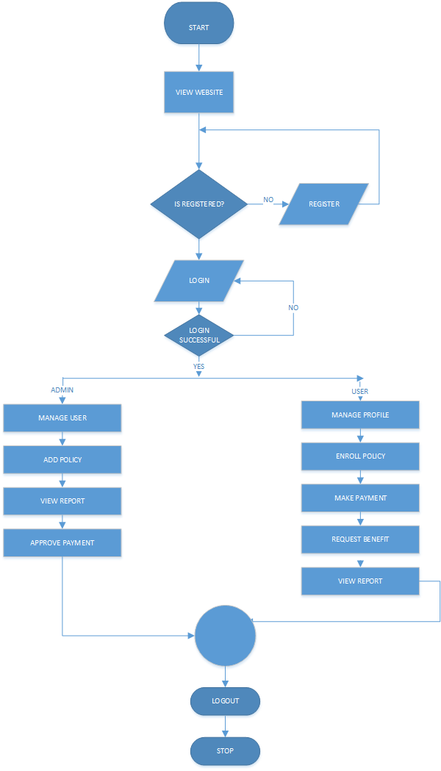
SYSTEM FLOWCHART OF THE SYSTEM

Slide 10
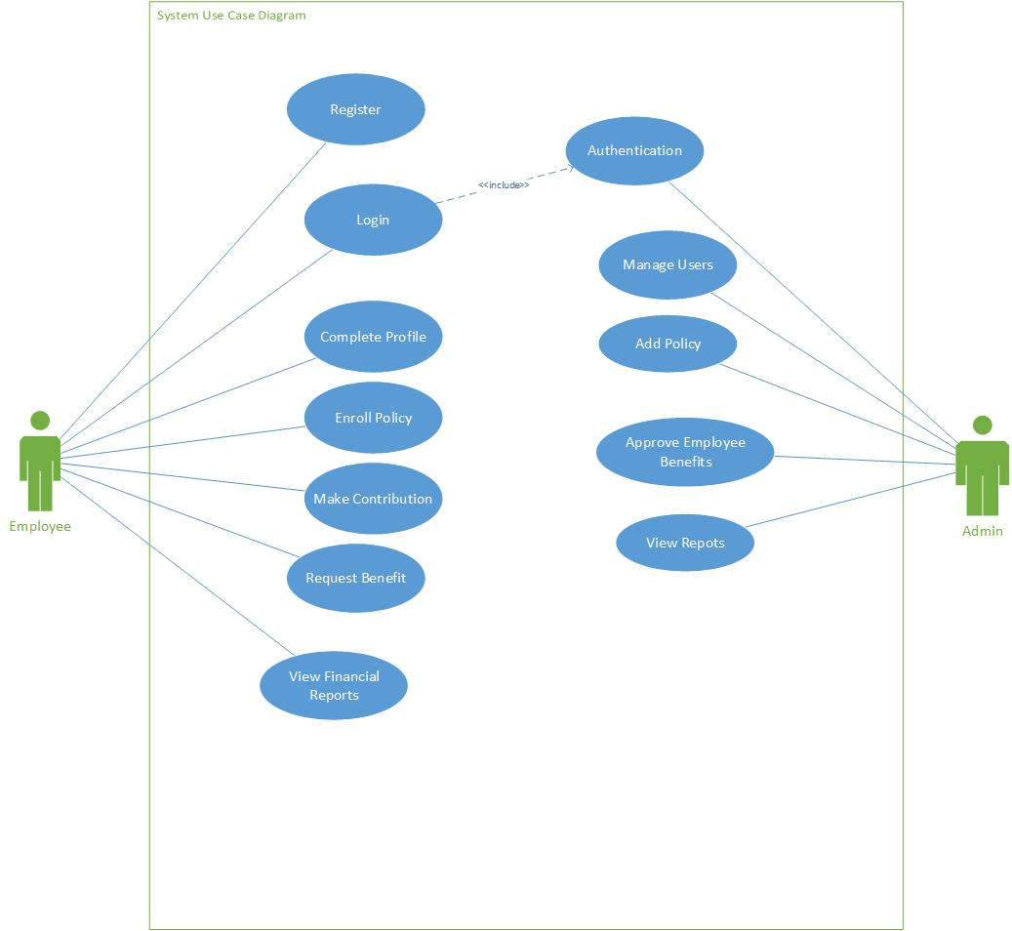
USE CASE DIAGRAM OF THE SYSTEM

Slide 11
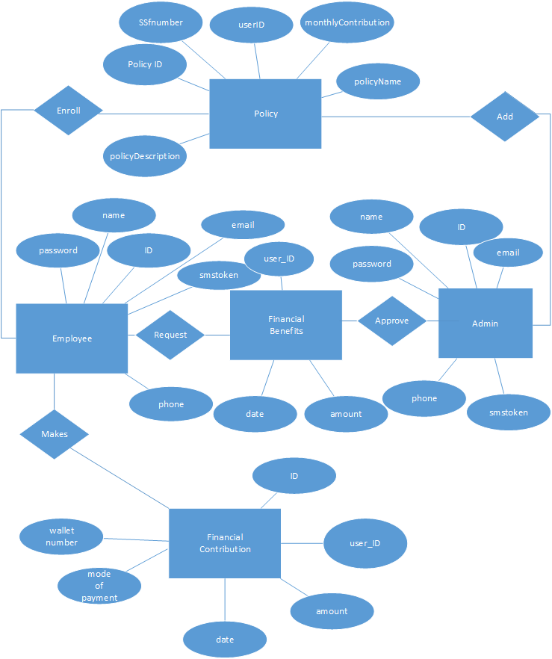
ENTITY RELATIONSHIP DIAGRAM SYSTEM

Slide 12
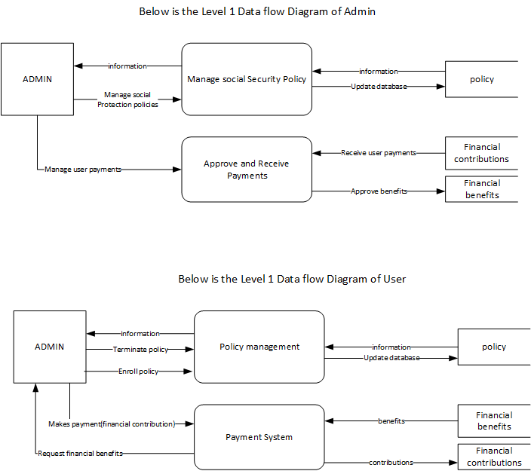
DATA FLOW DIAGRAM OF THE SYSTEM
User
Policy enrollment

Slide 13
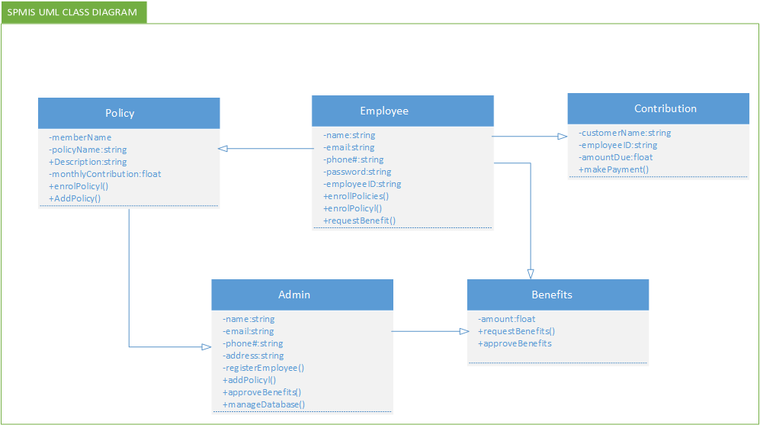
UML CLASS DIAGRAM OF THE SYSTEM

Slide 14
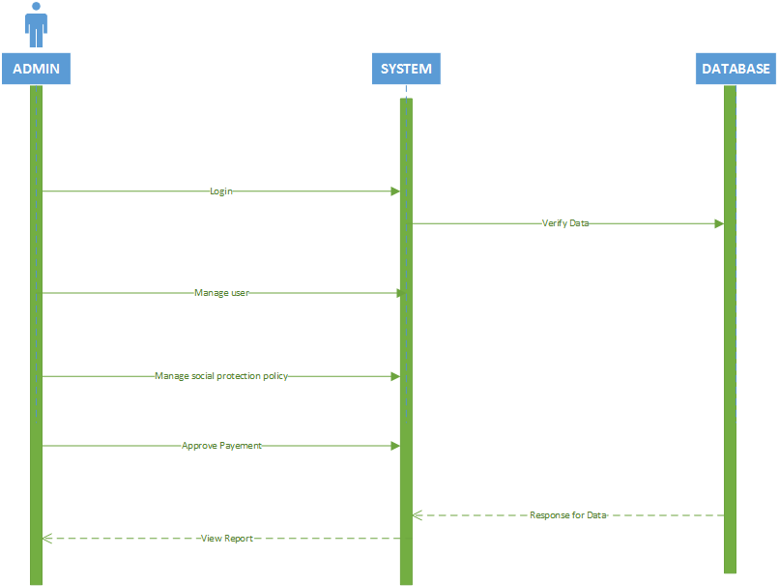
SEQUENCE DIAGRAM OF THE SYSTEM (ADMIN)

Slide 15
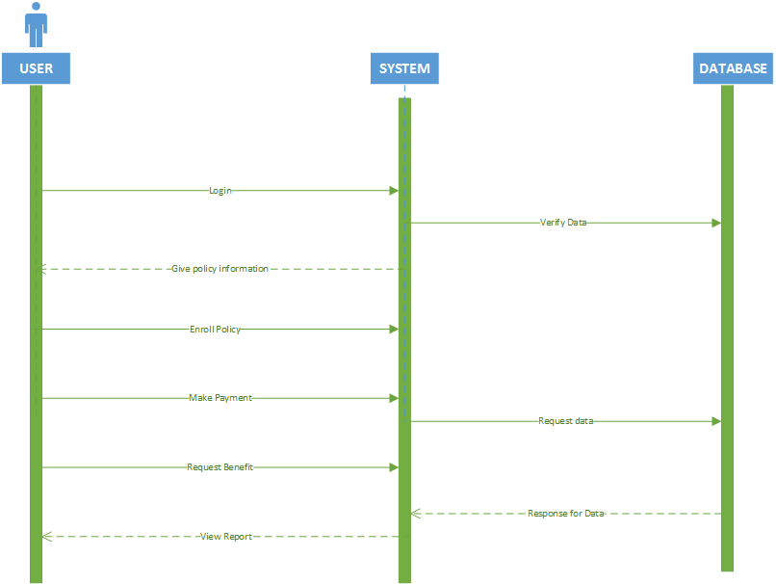
SEQUENCE DIAGRAM OF THE SYSTEM (USER)

Slide 16
WEBREADER API INTEGRATION
A webreader API was integrated into the management system with the hope to help users with disabilities better interact with web application. This will encourage the enrollment of persons with disabilities into social protection schemes

Slide 17
Future Recommendations
My recommendation is that in future, the SPMIS system can integrate blockchain technology(smart contracts) whereby potential members of the program can make monitory contributions using cryptocurrencies like bitcoin or ethereum since technology is veering to Web 3.0 in the 21st Century

